Slide 1

Investigation and simulation of card counting
By: Andrew Murray

Slide 2

Motivation for choosing project
Ensure a unique approach to current literature
Real world application
Literature review

Slide 3
Methodology:
Establishing the key fundamentals of my project:
What is Blackjack
Casino rules
Strategy
Card counting methods
What I was going to measure (parameters) and how
How was I going to conduct my investigation (design and implementation)
Outcome (analysis, results and conclusion)

Slide 4
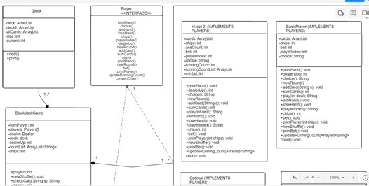
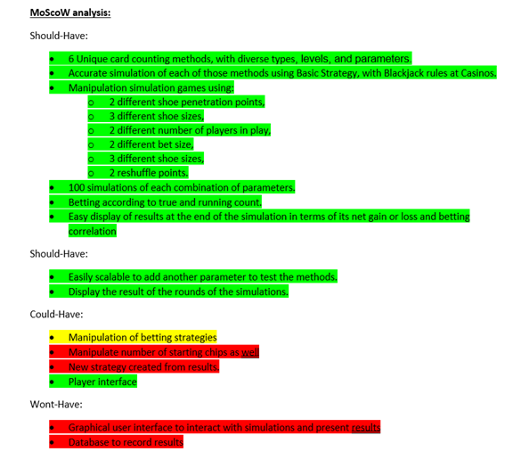
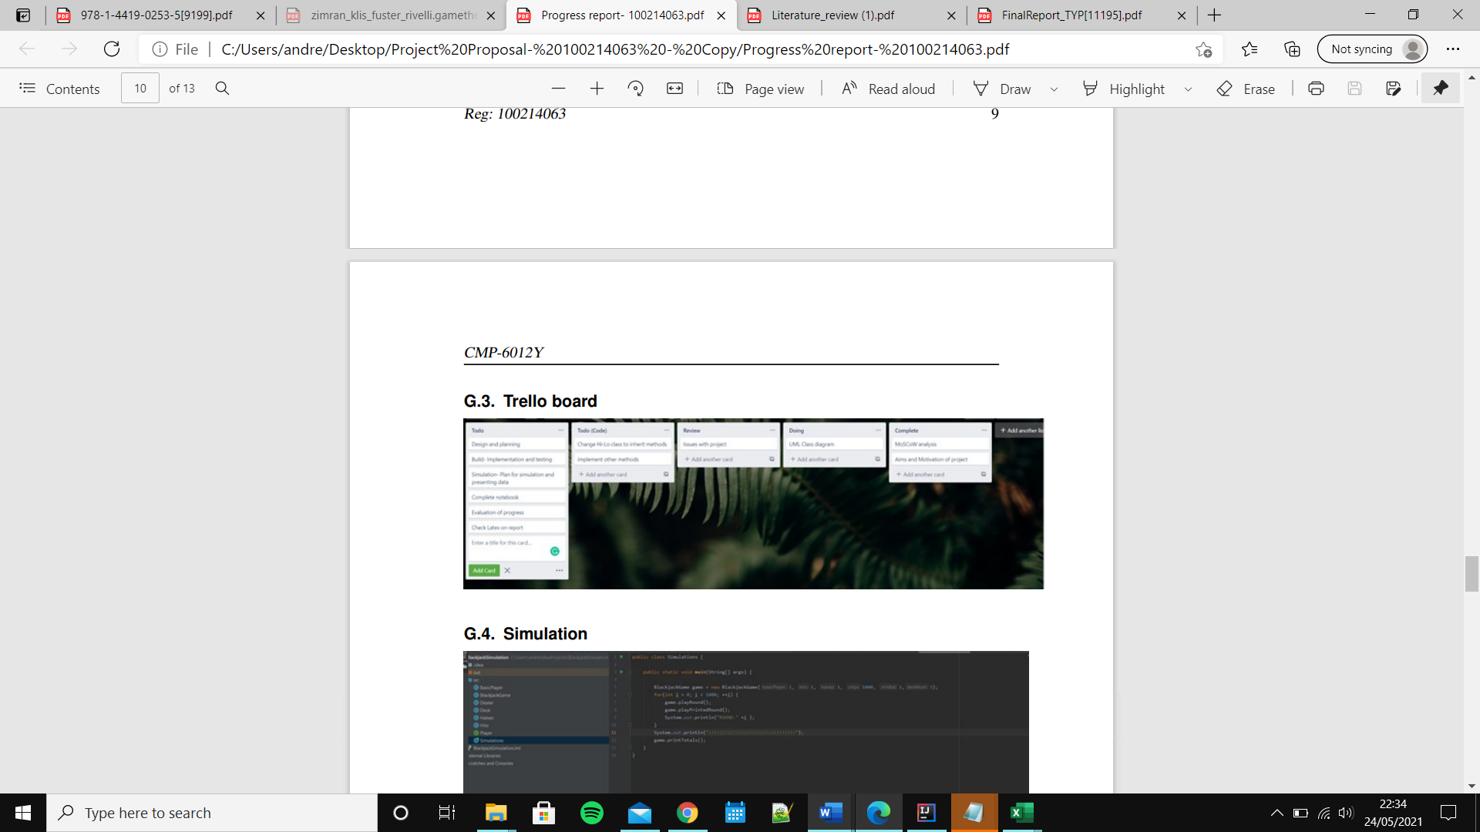
Methodology

Slide 5
The implementation
Following the designs, program was formed that can perform simulations that meet the described criteria shown by the MoSCoW diagram. Each method is run alongside itself (2 players of same method) each possible combination of parameters twice (in the same simulation) to double the data for a given combination to improve accuracy of data.
A demonstration will be shown following the presentation on:
the input required for a simulation
the program itself
The results and data collection plan

Slide 6
Problems faced undertaking project
Ambiguity:
Finding accurate figures for the parameters.
Haigh, J. (2010) stated that Double after splitting (DAS), surrender and re-splits was not an option in most casinos but is included in the Basic Strategy.
Different sources suggested different betting strategies for the same method.
Inherent:
Doesn’t account for human interpretation of the parameters, even within the same casino, different dealers will have different guesses.
More aggressive betting strategies are more likely to be flagged by casino’s and more stricter parameters imposed.

Slide 7
How I solved them
When calculating true count, the deck size given were rounded to provide a less accurate result to simulate a human guess.
The betting strategy was selected by the most popular given the method. (if 2 sources advocated 1-5 betting units and 1 advocated 1-16, then the former was selected).
Double after splitting (DAS), surrender and re-splits not considered, to make the results relevant to the majority of casinos.
Human error ignored for dealing.
The casino’s action to card counting not taken in account.

Slide 8
Implementation issues
Penetration and reshuffle rate
Methods could bet after remaining betting units were below 0
Input for deck size

Slide 9
Lessons I have learned
More thorough testing, much of my work was made redundant due to nature of the error which was realised incredibly late into the project. Despite appropriate time allocation to the report, the bug meant I had to restart a massive section with incredibly little time as it did not reflect my project goals.
Working solo iteratively, using trello. Prior to this project, I had worked using an iterative approach as a team for software engineering, however, the dynamic was different working alone and it taught me how to manage various aspects of the project by managing my focus on a weekly basis. Furthermore, it taught me the importance of splitting the project into manageable tasks as it seemed overwhelming as a whole. In addition, it allowed me to stay on track, up to the error stated previously.

Slide 10
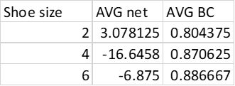
Results-parameters
As there was only 2 events of instances bust rate for a singular method, both for the zen 2.
Parameters:
Number of players
Shoe size
Minimum betting value
Penetration
Shuffle rate
Table 1- Shoe size data

Slide 11
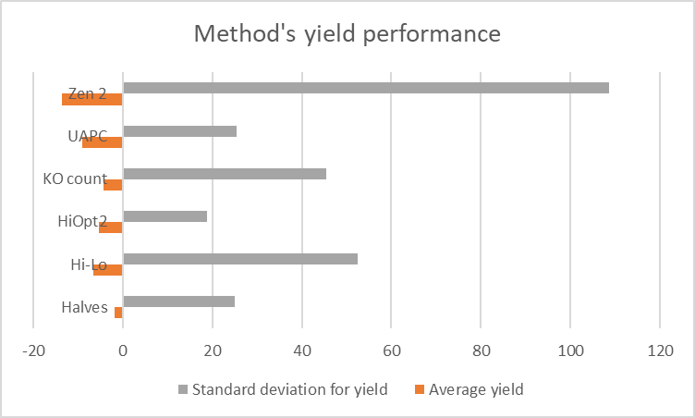
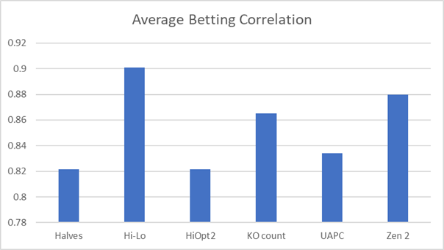
Results- Methods

Slide 12
Conclusion
Across the combined simulations, KO count proved the most successful in terms of the important factors when betting at a casino, the return and its reliability. Whilst, its reliability is not as high as others, the rate of return solidifies its place as the most effective method given human capability. Furthermore, as it is unbalanced, calculations are easier than balanced methods.
Furthermore, the results concluded that ,despite the various attempts to calculate the effect of removal, the ‘house edge’ can’t be shifted to the player given the parameter combination at least 10% penetration, 20% reshuffle rate, 2 decks in shoe and 2 players at the table and minimum bet value of 1 (assuming 200 starting units), which was the most lenient parameter combination I simulated in terms of giving a player an edge.

Slide 13
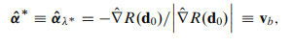
Going forward
Have a more accurate measurement formula for betting correlation, seen by Figure 1.
More extensive range of values for the parameters.
More simulations per combination to increase the accuracy of the project.
Shift penetration and reshuffle rate to the Simulation class to be handled as input
Analysis of a method given a certain parameter value
Figure 1- Haigh, J. (2010) Betting Correlation equation

Slide 14

Questions?

